Slide 1
Uncovering Guest Dissatisfaction: Theme Analysis of Negative Cruise Feedback
Examining causes and insights from cruise passenger complaints
Notes:
AI-generated content may be incorrect. --- This presentation explores the main causes of guest dissatisfaction on cruises by analyzing negative feedback. We will examine the key questions guiding the analysis, the methodology used, and insights across different ship classes to better understand and address complaints.

Slide 2
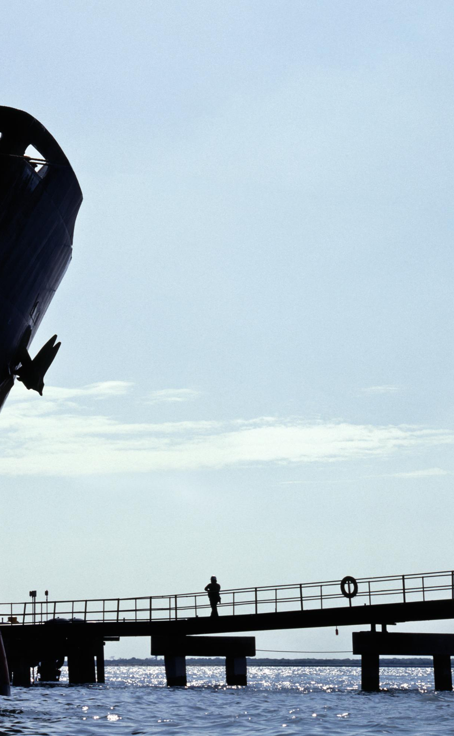
Key Purpose and Questions of Complaint Analysis
Purpose of Complaint Analysis
The main goal is to identify cruise experience factors causing negative guest feedback for improvement.
Identifying Complaint Themes
Analyzing complaints to uncover recurring themes that highlight guest concerns and dissatisfaction.
Variation by Ship Class
Examining how complaint themes differ depending on cruise ship class to tailor improvements effectively.
Actionable Insights
Deriving practical recommendations from complaints to enhance guest satisfaction and experience.
Notes:
--- The core purpose is to uncover what aspects of the cruise experience lead to negative guest feedback. Key questions include: What themes emerge from complaints? How do these themes vary by ship class? What actionable insights can be drawn to enhance guest satisfaction? Image source: Microsoft 365 content library

Slide 3
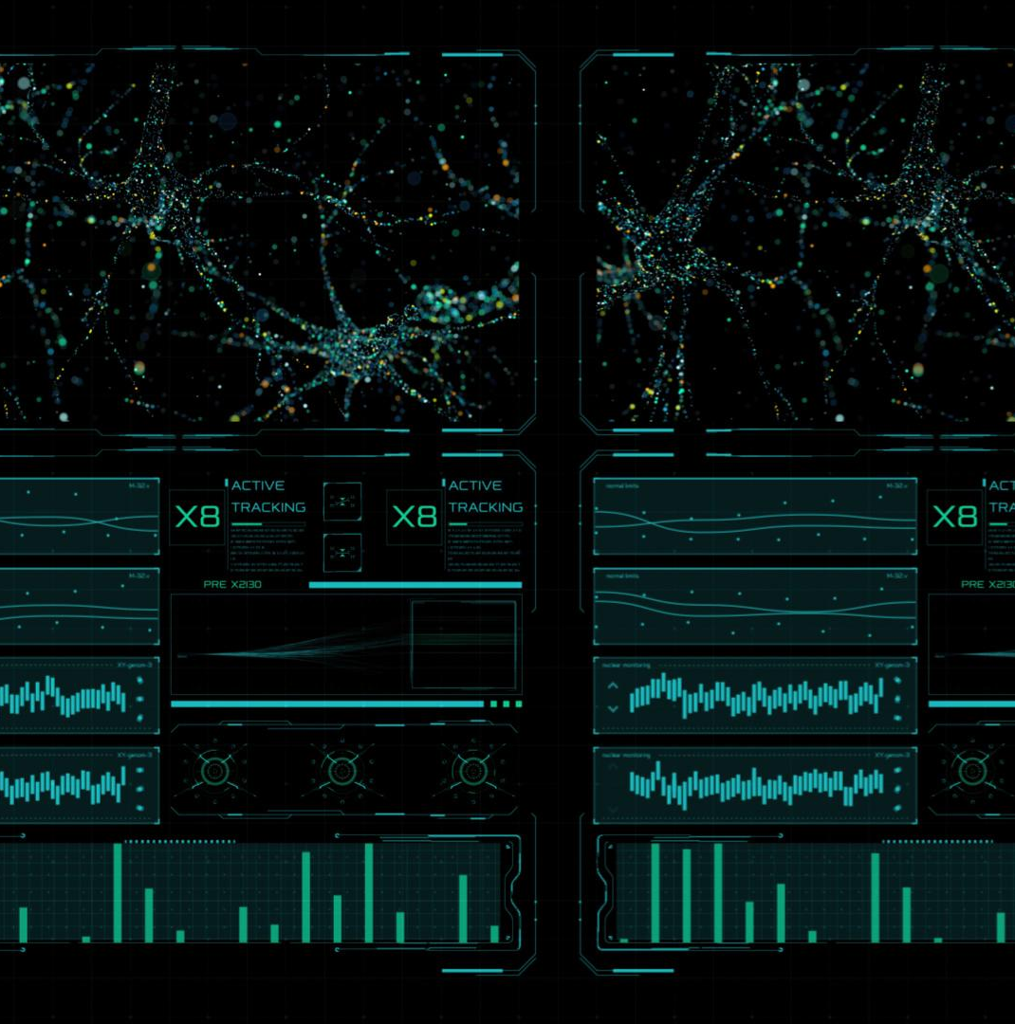
Methodology: Sentiment and Theme Extraction Process
Sentiment Analysis Techniques
Sentiment analysis was used to quantify negative sentiments in guest feedback, assisting in understanding customer emotions.
Thematic Coding Approach
Thematic coding helped systematically identify recurring complaint themes across the dataset.
Notes:
--- We employed sentiment analysis techniques combined with thematic coding to extract and categorize complaints from guest feedback. This process enabled us to quantify negative sentiments and identify recurring themes systematically across the dataset. Image source: Microsoft 365 content library

Slide 4

Major Complaint Drivers Across Ship Classes
Service Quality Issues
Service quality is a major complaint driver, impacting guest satisfaction across all ship classes.
Food and Dining Concerns
Food and dining experience varies in importance but remains a key dissatisfaction factor for many passengers.
Cabin Condition Complaints
Cabin conditions influence guest comfort and are common sources of complaints on different ship classes.
Entertainment Expectations
Entertainment quality and variety affect guest satisfaction and vary according to ship class expectations.
Notes:
--- Analysis revealed common dissatisfaction drivers such as service quality, food and dining, cabin conditions, and entertainment. However, the prominence of these themes varied depending on the ship class, reflecting different guest expectations and operational factors. Image source: Microsoft 365 content library

Slide 5
Class-Specific Insights and Implications
Luxury Class Complaints
Luxury class guests prioritized issues related to personalized service and attention to detail.
Budget Class Complaints
Budget class passengers emphasized concerns about value for money and cleanliness standards.
Targeted Improvements
Recognizing distinct complaint patterns enables tailored improvements and marketing strategies.
Notes:
--- Each ship class exhibited unique complaint patterns. For example, luxury class guests focused more on personalized service issues, while budget class passengers highlighted value and cleanliness concerns. Understanding these nuances is essential for targeted improvements and marketing strategies. Image source: Microsoft 365 content library

Slide 6
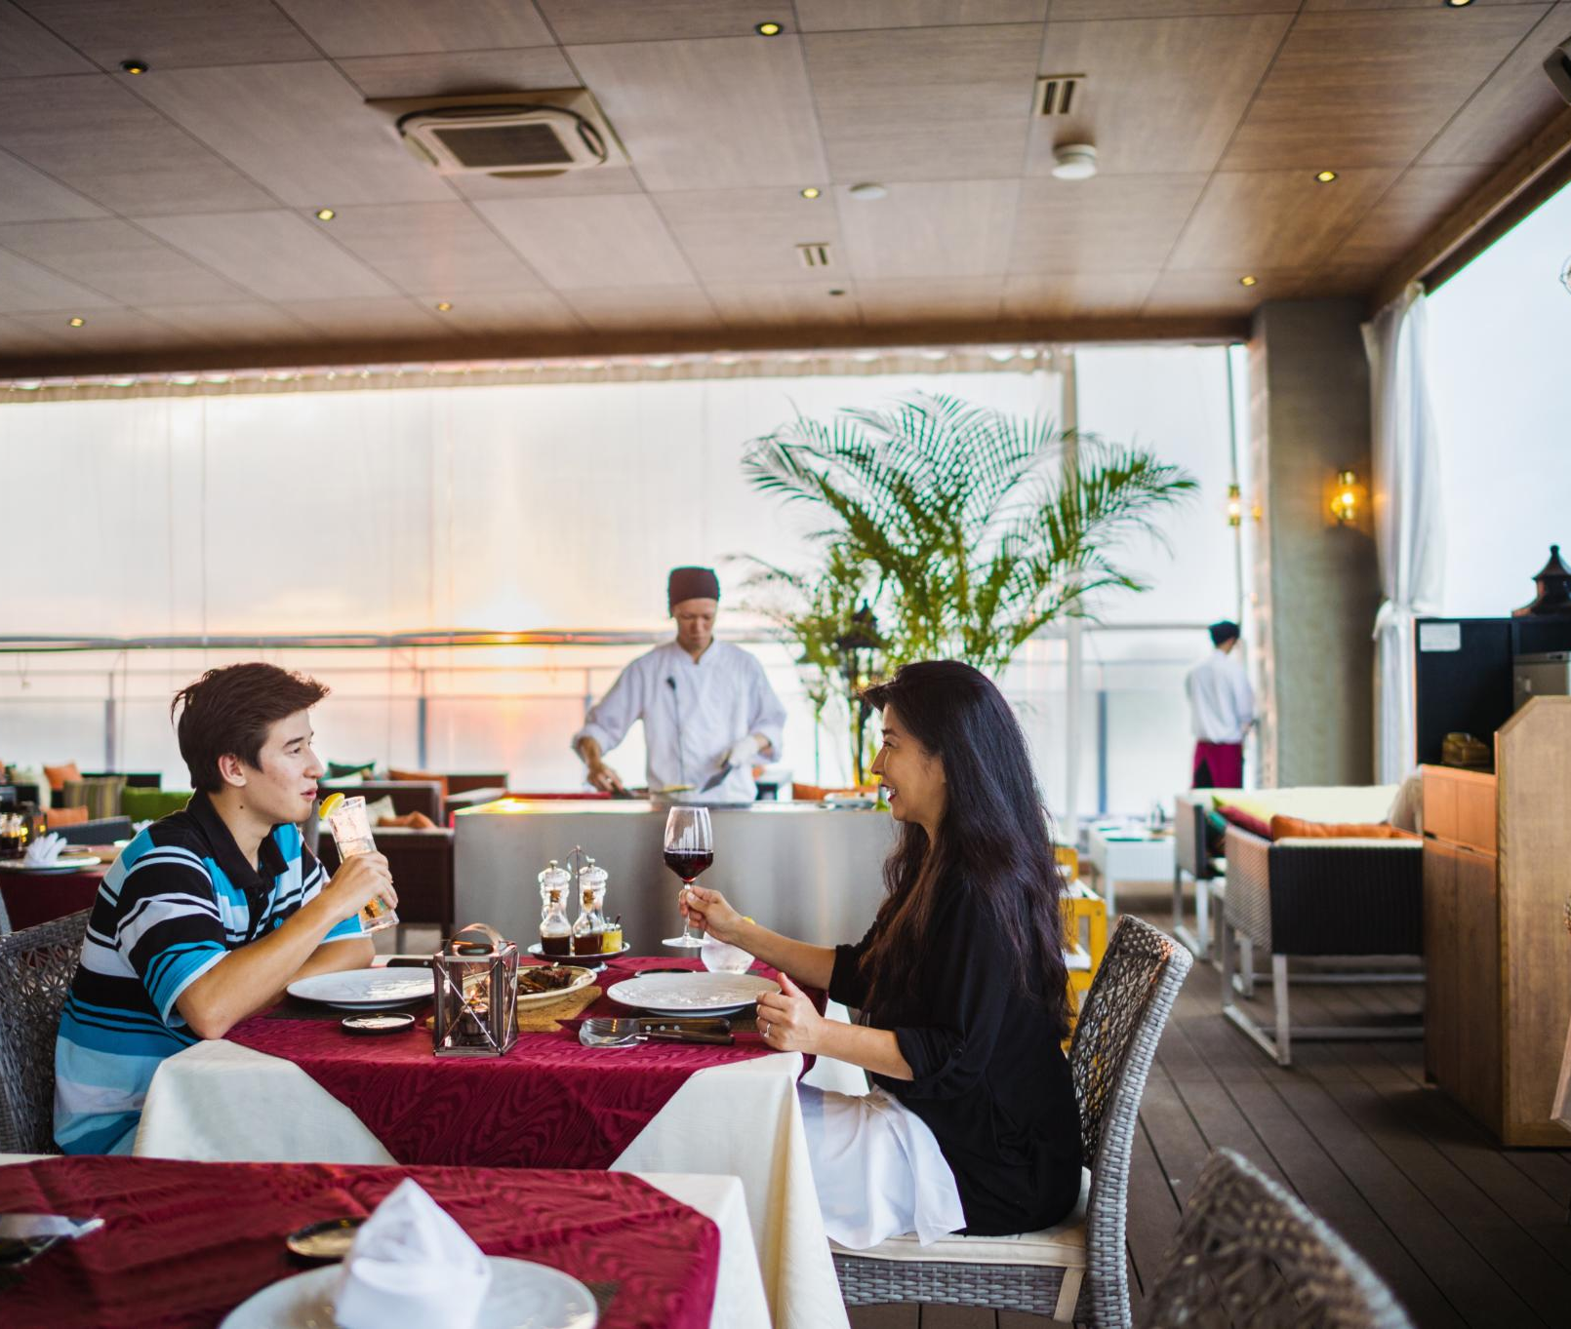
Driving Satisfaction at NCL
Enhance Food and Dining
Improving food and dining quality is the most impactful way to boost guest satisfaction across the fleet.
Consistent Service Improvements
Delivering consistently excellent service on all ships ensures a positive experience for every guest.
Targeted Cabin Upgrades
Addressing specific cabin issues, especially on the Epic and Dawn, will resolve major comfort concerns.
Align Marketing and Experience
Ensuring premium marketing matches the actual onboard experience builds guest trust and loyalty.
Notes:
Image source: Microsoft 365 content library Enhancing food and dining quality provides the greatest opportunity to increase guest satisfaction. Consistent service improvements will positively impact all ship classes, while cabin issues require targeted actions for specific ships. Recommended steps include improving dining and service processes now, prioritizing Epic & Dawn cabin upgrades, and ensuring premium marketing aligns with onboard experiences.

Slide 7
Conclusion
Analyzing Negative Feedback
Systematic analysis of negative guest feedback helps identify specific areas needing improvement on various ship classes.
Tailored Improvements
Improvement strategies are customized for each ship class to directly address guest concerns effectively.
Enhanced Guest Experience
Data-driven enhancements increase guest satisfaction, loyalty, and overall cruise experience quality.
Notes:
By systematically analyzing negative guest feedback, cruise operators can pinpoint key areas for improvement tailored to each ship class. This data-driven approach supports enhancing guest satisfaction, loyalty, and overall cruise experience.

